Slide 1
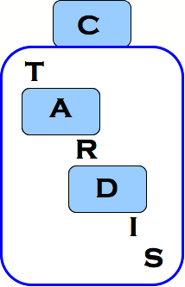


TARDIS Status Triple Antiplatelets for Reducing Dependency after Ischaemic Stroke

Slide 2


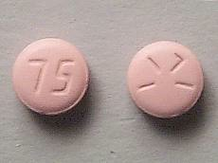
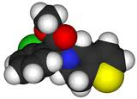
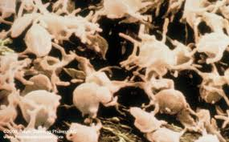
Triple Antiplatelets for Reducing Dependency after Ischaemic Stroke
www.tardistrial.org
Do intensive antiplatelets reduce recurrence?
Patients: Ischaemic stroke or TIA within 48 hours
Intervention: Intensive – Aspirin + Clopidogrel + Dipyridamole
Comparator: Guideline – Aspirin/Dipyridamole/Clopidogrel
Treatment for 30 days
Outcome: Stroke and its severity using mRS
N: 2,779 0f planned 4,100 participants
Internet: Randomisation, data collection, trial management
Funding: British Heart Foundation; HTA
Status: Stroke 1,900 (68%) – C 56% AD 44%
TIA 879 (32%) – C 44%, AD 56%

Slide 3
TARDIS: Trial Flow
Stroke or
TIA (<48)
Intensive therapy
Guideline therapy
(triple therapy)
(mono/dual therapy)
(ACD) for 1 month
(
Randomised
1:1)
(AD or C) for 1 month)
Assessment at days 7 and 35 for
safety, efficacy, tolerability & FBC
90 day central blinded telephone
follow up and end of the trial
www.tardistrial.org

Slide 4
TARDIS: Trial summary
Timeline 1 Apr 2009 –
30 Mar 2017
UK sites 106 of 135
Countries 4
Overseas sites 7
Countries in start up 2
www.tardistrial.org
Notes:
Countries most likely to start first are Denmark, Sweden, Georgia

Slide 5
TARDIS: Countries (centres)
Active:
Denmark 3
Georgia 3
New Zealand 1
UK 106
www.tardistrial.org

Slide 6
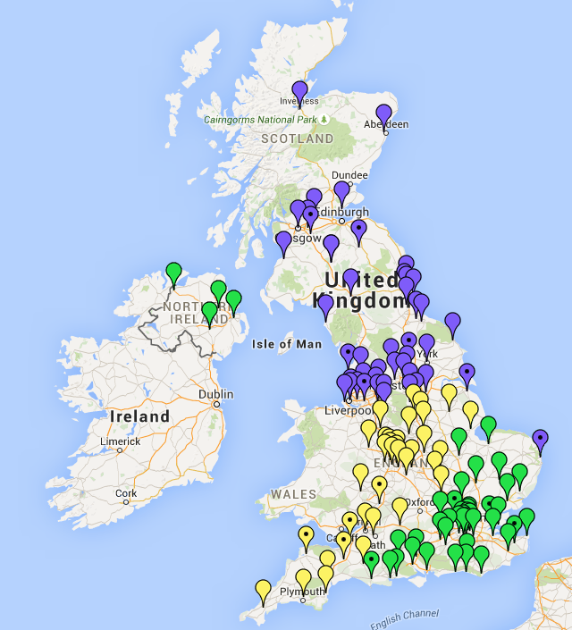
TARDIS: UK
Aberdeen
Aintree
Airdrie
Ashford
Ashington:
Wansbeck/N Tyneside
Ayr
Barnsley
Barnstaple
Basildon
Basingstoke
Bath
Birmingham
Blackpool
Boston
Bournemouth
Brighton
Bristol
Calderdale
Cambridge
Canterbury
Carlisle
Carshalton
Chester
Chesterfield
Colchester
Coventry
Croydon
Cumberland
Derby
Devon
Dewsbury
Doncaster
Dorchester
Eastbourne
Exeter
Frimley Park
Gateshead (QE)
Gillingham
Glasgow
Gloucester
Great Yarmouth
Grimsby
Guildford
Halifax
Harrogate
Haywards Heath
High Wycombe
Inverness
Ipswich
Kettering
Kirkcaldy
Kings Lynn
Kingston
Larbet
Leeds
Leicester
Lincoln
Liverpool
London
Macclesfield
Manchester
Mansfield
Margate
Melrose
Milton Keynes
Newcastle
Nottingham
Northampton
Peterborough
Plymouth
Poole
Prescot
Preston
Rotherham
Salford
Scarborough
Sheffield
Southampton
Southend
St Helier
Stirling
Stockport
Stoke
Sunderland
Swindon
Taunton
Torquay
Truro
Wansbeck
Warrington
Warwick
Watford
Westcliffe on Sea
Whitehaven
Wigan
Winchester
Wishaw
Worthing
Yeovil
Ireland
Co. Armagh
Antrim
Belfast
Londonderry
www.tardistrial.org

Slide 7
Recruitment: Issues
Recruitment numbers have declined over the summer increasing the required monthly recruitment to almost 70 patients per month
The number of sites requesting closedown is increasing, resulting in coordinator time being spent in closedown and not set up and monitoring
Increased number of withdrawals from treatment
Increased withdrawals from follow-up
Limited recruitment at week-ends
www.tardistrial.org
Notes:
7
Next slide shows that recruitment generally slows down in the autumn posing a problem if we require an increased monthly recruitment rate

Slide 8
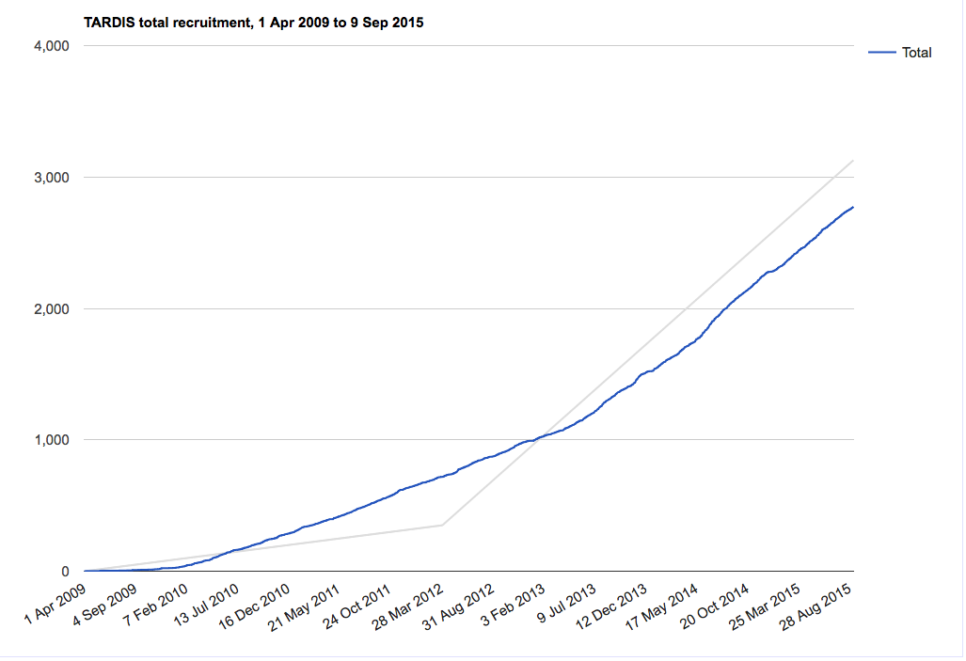
TARDIS: Recruitment summary
www.tardistrial.org
Notes:
Monthly target for the first 12 months is 50 and after 12 months 70 a month. Monthly average is 29, so we need to rapidly increase recruitment. Start up phase over recruited, so helped us initially, but we need to achieve monthly recruitment target for the main phase soon or risk HTA intervening.

Slide 9
TARDIS: Recruitment summary
Target 4100
Actual 2779
Last 6 months 61.2 per month
Last 3 month 56.8 per month
Required monthly recruitment risen to 67.5 per month!
www.tardistrial.org
Notes:
Updated numbers to be added on Monday

Slide 11
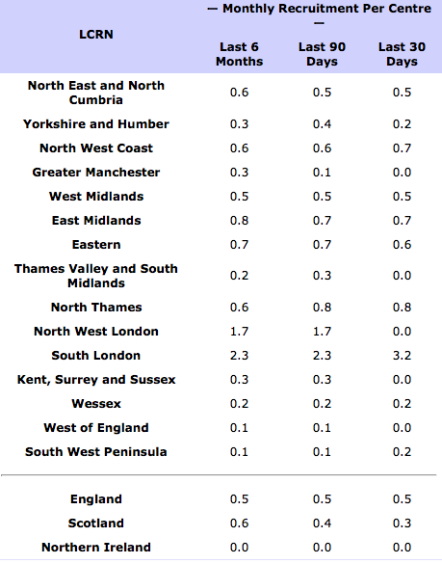
TARDIS: Recruitment by LCRN
www.tardistrial.org
Notes:
Couldn’t work out how to do site recruitment. Not sure whether this is useful or not.

Slide 13
Notes:
13
TIA ratio is low bearing in mind few other competing TIA studies
Reminder to complete day 7 and 35 visits. Plus/minus 1 day and plus/minus 3 days for day 35. Rather have it early/late than not at all if patients are finding it difficult to get in. Aware cannot enter day 35 data if day 7 is not in. If have paper copies of day 35, let us know.

Slide 14
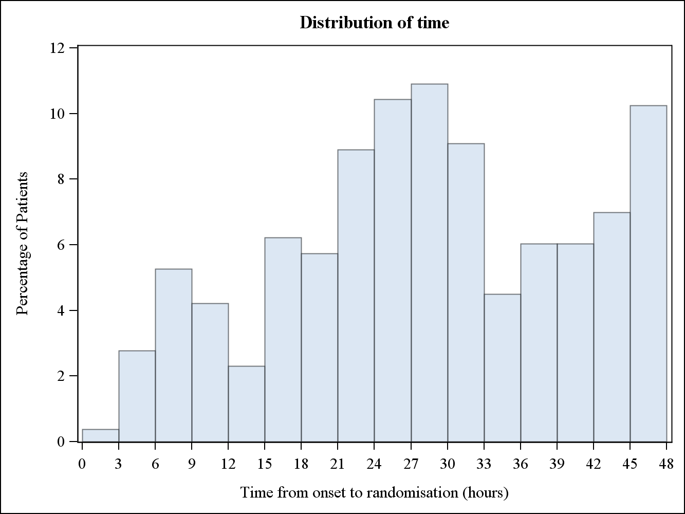
Recruitment: Issues
www.tardistrial.org
Implications of late recruitment:
Lower event rate so less statistical power
Replicate ENOS: neutral trial because not enough patients recruited early!
Notes:
14
TIA ratio is low bearing in mind few other competing TIA studies
Reminder to complete day 7 and 35 visits. Plus/minus 1 day and plus/minus 3 days for day 35. Rather have it early/late than not at all if patients are finding it difficult to get in. Aware cannot enter day 35 data if day 7 is not in. If have paper copies of day 35, let us know.

Slide 16
TARDIS: Payments to UK Sites
Site £
Start-up (when recruited 5 patients) 100
Per patient (£50)
Data management 25
Offices expenses 25
Patient travel (days 7, 35), on receipt <50
Carotids (if not clinically indicated) 50
CT/MR CD (where upload not possible) 10
www.tardistrial.org

Slide 17
TARDIS: Who’s who
Trial Manager Di Havard
UK Coordinators Margaret Adrian, Michael Stringer & Jamie Longmate
International Coords Jo Keeling, & James Kirby
Follow-up Coords Jo Keeling, James Kirby & Jenny Smithson
Programmer Richard Dooley
Data & Imaging Dawn Hazle
Administrator Yvonne Smallwood
Statistician Lisa Woodhouse
Tel: +44 (0) 115 823 1770
Fax: +44 (0) 115 823 1771
Email: tardis@nottingham.ac.uk
Websites: www.tardistrial.org
www.tardistrial.org
Notes:
During the breakout sessions we will let everyone know which UK coordinator is looking after each site
Please could you ask people not to use the e-mail address for randomisation queries

Slide 18

Thank you!
Best recruitment in August:
London Kings 5, London Barts 5
Boston, Pilgrim 4
Average time to recruitment
Coventry 11.23hr
Highest recruiting centres
Nottingham 209
Stoke 189
www.tardistrial.org
Notes:
During the breakout sessions we will let everyone know which UK coordinator is looking after each site
Please could you ask people not to use the e-mail address for randomisation queries

Slide 19
TARDIS
Any questions?

